Slide 1
Marketing Retail Analysis: Capstone Project
Namita Verma

Slide 2
Docket
Objectives
Background
Visualizations
Insights
Recommendations
Appendix –
Data Sources
Data Methodology
Data Assumptions

Slide 3
Objective
To identify top products that contribute to the revenue and top product category using Pareto Analysis.
Improve our understanding with the use of market basket analysis to analyze the purchase behavior of customers.
Understand what items are most likely to be purchased individually or in combination with some other products.

Slide 4
Background
In customer purchase pattern we could see that majority orders were placed between 10AM to 4PM
The most preferred type of payment is credit card so we could provide some offers on the same to attract customers
Most orders were placed from Sau Paulo city from SP state followed by Rio de Janeiro, Belo Horizonte from MG and Brasilia from DF.

Slide 5
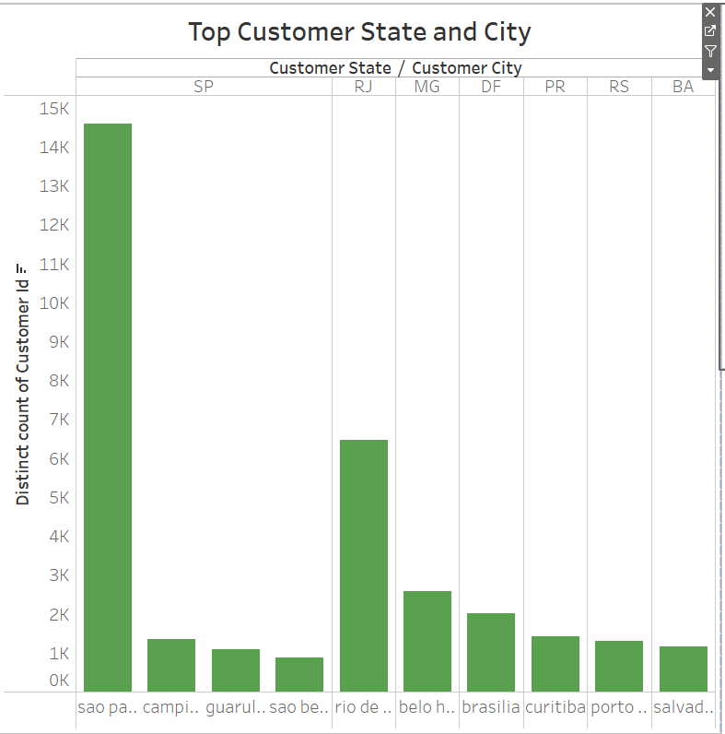
Top customer State and City
Sao Paulo city in Sao Paulo state is the customer state which stays top at the customer counts.
Campinas, Guarulhos & Sao Bernardo do campo are the rest cities that contribute the sales of the state Sao Paulo.
2nd most customer magnet city is Rio-De Genero and along with that Belo Horizonte stays 3rd on the same list.

Slide 6
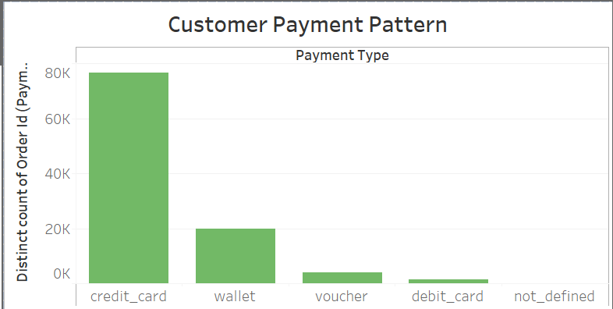
Top Customer payment Pattern
The most common payment mode used by customers is credit card, 76,505 are the number of credit cards payments recorded.
Second preferred us wallet, 19,748 numbers of payments are recorded till now.

Slide 7
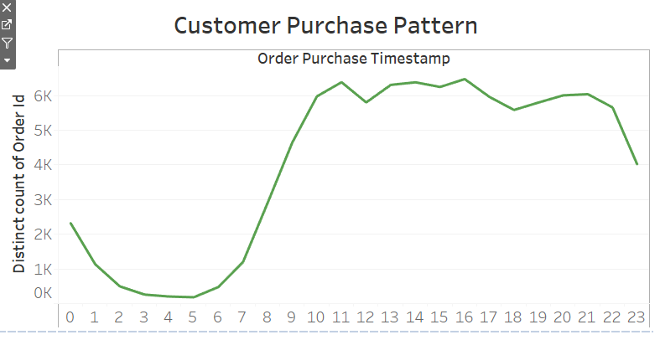
Customer Purchase Pattern
Highest number of sales that had appeared in the time stamp of 11 AM, with distinct count of orders stays 6,385.

Slide 8
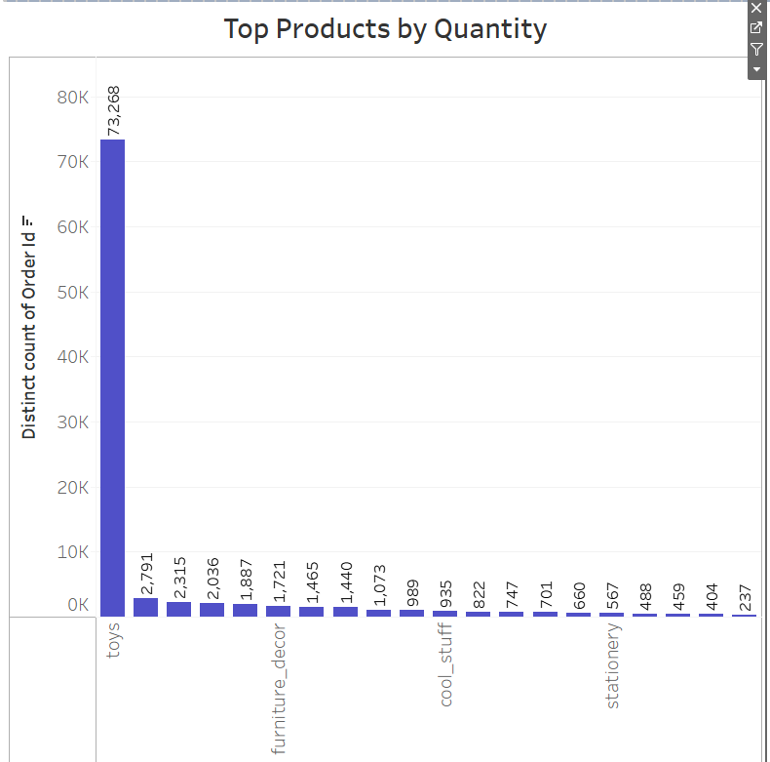
Top Products w.r.t Quantity
Toys category is the most ordered category with a total of 73,268 orders.
Furniture décor stays second in the line with 1,721 orders

Slide 9
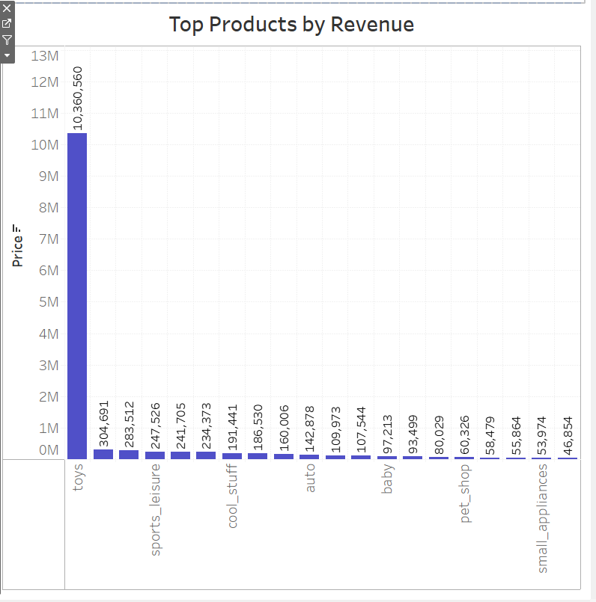
Top Products w.R.T Revenue
Toys category is the most ordered category with a total of 73,268 orders.
Which in return makes it highest revenue attracting product.

Slide 10
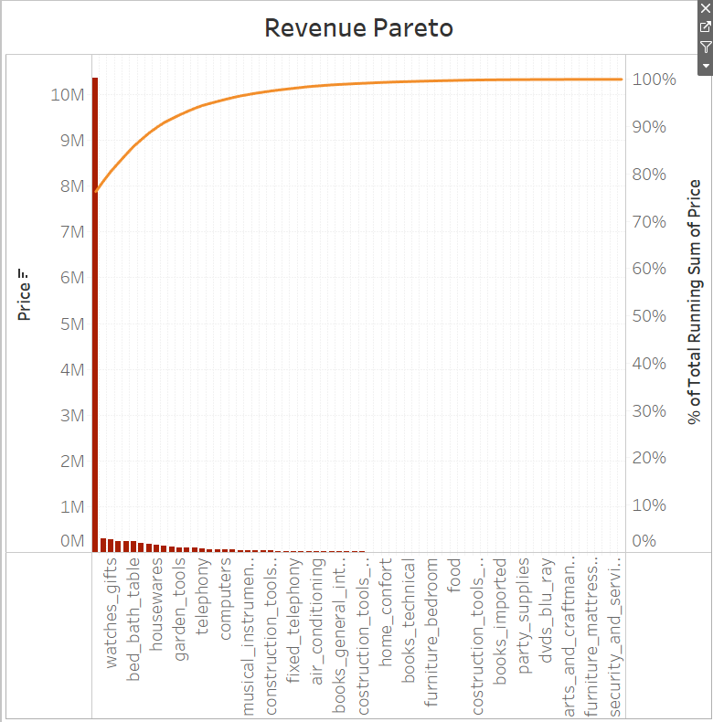
Revenue Pareto
Toys, health_beauty and watches_gift combine generate 80.56% of the revenue.
Toys alone generates 76.23% of the revenue.
The rest of the 70+ product categories generates 19.44% of the revenue.

Slide 11
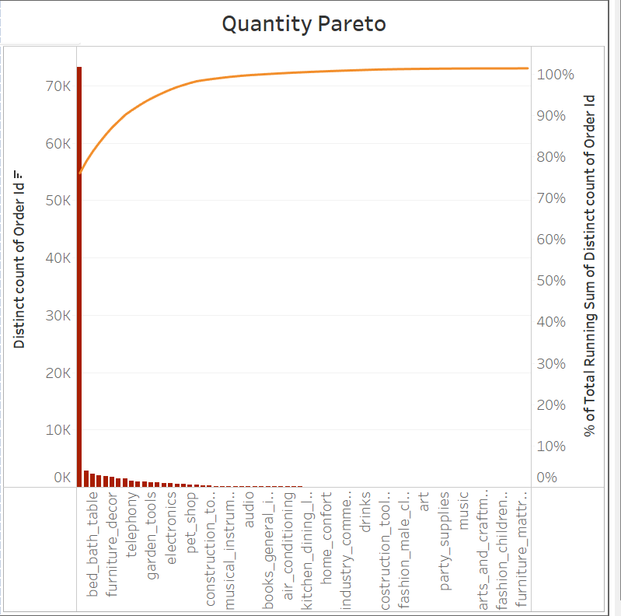
Quantity Pareto
Toys, health_beauty and bed_bath_table make up 80.38% of the total orders.
Toys alone has 75.94% of the total orders.
The rest of the 70+ product categories generate 19.62% of the total orders.

Slide 12
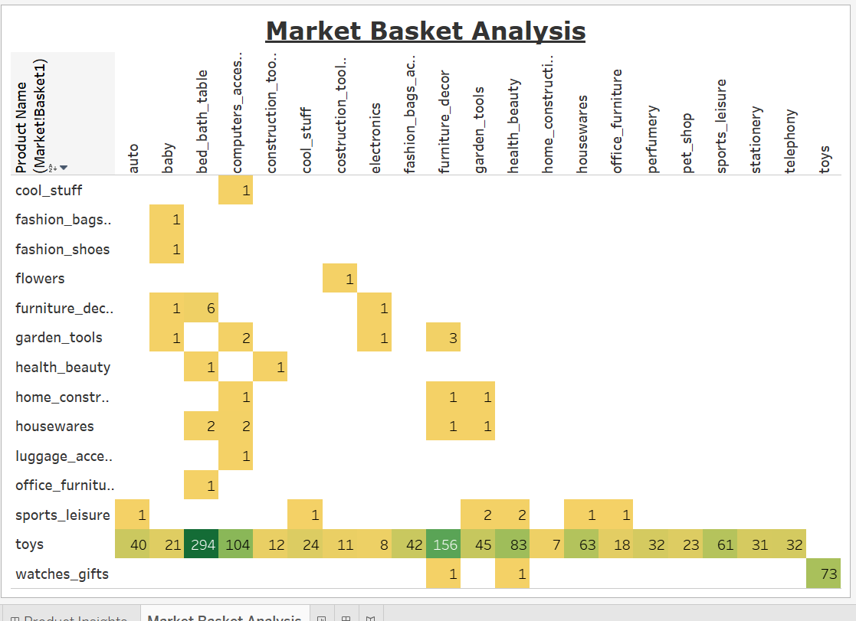
Market Basket Analysis
Market Basket Analysis is performed to identify the frequently ordered category association.
Toys are the most ordered category along with the categories of bed_bath_table, furniture_decor, computers_accessories and health_beauty.

Slide 13
Insights
The category Toys constitute 20% of the products which generates 80% of the revenue.
It can be seen that even if the price of the certain products is high, it is still bought by the customer more often.
Apart from Toys, the products from the categories of bed_bath_table, furniture_decor, computers_accessories and health_beauty are the most frequently ordered. The above categories with Toys or/and with each other are most frequent in customers’ basket.
It is observed that despite of the high price, some products are frequently purchased by the customers.

Slide 14
Recommendations
The company should focus on the categories which generate more than 80% of the revenue by always keeping them in stock.
The company should target customers who are more likely to buy toys to boost sales as the category toys is the most ordered category.
Offer promo-codes or discounts on the frequently ordered category associations to encourage cross selling among the products.
The company can reduce some of the sub categories which have very low sales.

Slide 15
Appendix - Data Sources
Here is a snapshot of our data dictionary:
Order details such as order id, order status, order purchased timestamp, etc.
Order Items detail such as order item id, seller id, price, shipping charges, etc.
Customer details such as customer is, customer city, customer state, etc.
Payment details such as payment type, payment value, etc.
Product details such as product id, product category name, product dimensions, etc.
The following data sources were used:
OList retail dataset containing order-related information.
The data consisted for the year 2016 to 2018.

Slide 16
Appendix - Data Methodology
A thorough analysis of the OList Retail Dataset was conducted. The process included:
The dataset was cleaned and transformed using the Excel formulas like VLOOKUP, COUNTBLANK in the Microsoft Excel.
The missing values for the various columns were replaced with the best values.
The redundant and duplicate records were discarded and only first occurrences were kept.
Exploratory data analysis was done using the Excel graphs and boxplots were created to detect outliers in the data.
A new dataset consisting of order id and product category name was created for Market Basket Analysis.
Various visualizations and Market Basket Analysis was conducted in Tableau.

Slide 17
Appendix - Data Assumptions
Only the cases having order status as ‘delivered’ are considered.
We assumed that the data provided was achieving the desired revenue.
We assumed that the company does not want to expand to new warehouses.
The company’s strategies are decided considering there is constant growth in sales.
Thank you

